Slide 1

Hospital Call Center (HCC) - Case Study
Duong Thuy Le

Slide 2

Business Understanding

Slide 3
Business Statement
In the following analysis, we will journey through this dataset to unearth insights and address crucial questions.
Our goals are to conduct exploratory data analysis to summarize HCC's current state, identify critical questions that the HCC manager can pose, define a model for productivity, and create a user-friendly dashboard to empower business leaders to make informed decisions based on this invaluable data resource.
This multifaceted approach will enhance the efficiency of HCC operations and elevate the quality of patient care provided by the Hospital System.

Slide 4

Business Analysis

Slide 5
Overall
5-factor descriptive analysis
Daily Average Talk Time Trend

Slide 6
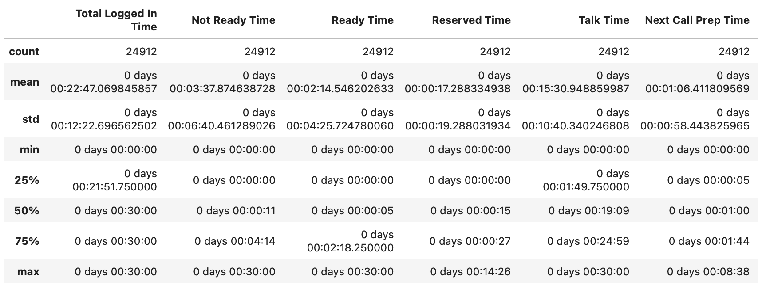
Overall
Descriptive Analysis for all the activities during the agent log-in time report to track the comment pattern in what tasks agents spent time on. 5 subsets: “Not Ready Time”, “Ready Time”, “Reserved Time”, “Talk Time”, and “Next Call Prep Time”

Slide 7
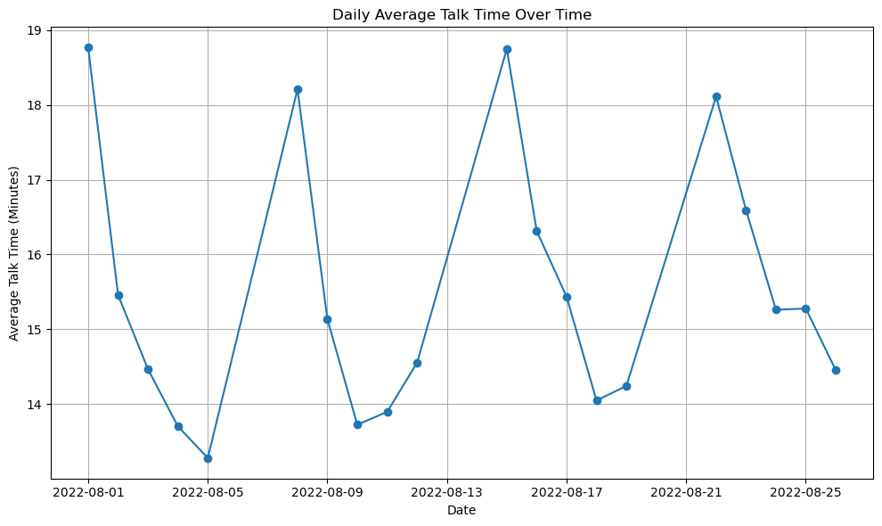
Daily Average Talk Time trend
Q) What is the trend for daily talk-time?
Analysis:
This is to track the trend on which days require more time to be on the phone, and which days consume less time for that, so that managers could reflect into Staffing Plan for more work-load balanced.
Overall, the trend was fluctuated strongly, the highest (busiest) time was on August 1st, while the lowest was on August 5th.
Hypothesis:
- This is due to the nature of the hospital? (For ex: Patients’ discharge/medical schedules)
- This is due to expertise allocation? (For ex: Senior staff could solve problems faster than Junior)

Slide 8
By Team
Team Allocation
Team’s performance (daily/weekly)

Slide 9
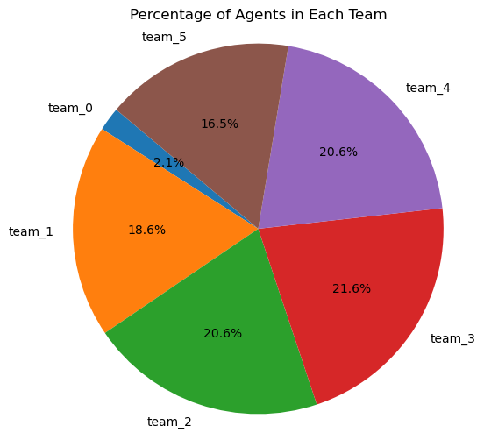
Team Allocation
Q) What is the ratio of each team in HCC?
Analysis:
Besides Team 0, the remaining 5 teams were distributed almost equally in the HCC.
Still, we need to check the staff allocation and its level balance between entry-level and senior, to make sure each team’s productivity.

Slide 10
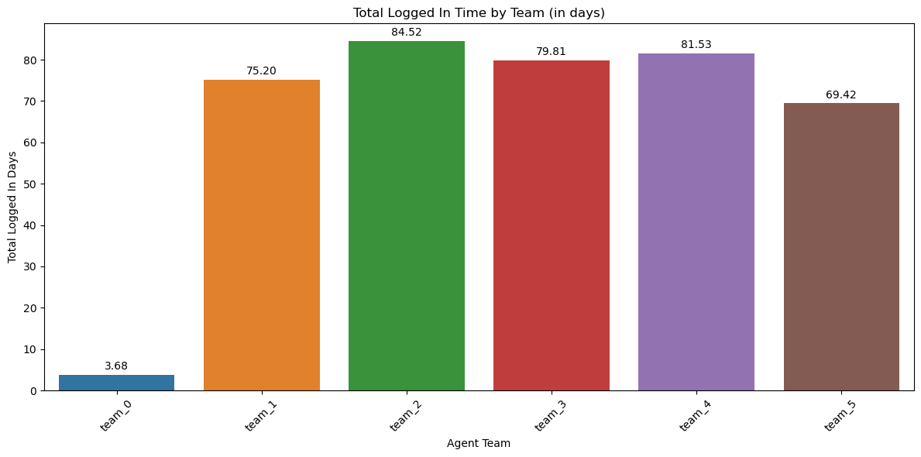

Total Logged In Time (weekly/daily)
Q) What is the total logged in time by team on weekly/daily basis?
Analysis:
Despite having the highest staff allocation (21.6%), team 3 has a lower logged-in time.
Team 2 and Team 4 have the same (20.6%) staff allocation but there is a gap between their logged-in team.
=> The manager needs to check the staffing allocation and make sure there is a link between the numbers of staff per team and the team logged in time.

Slide 11
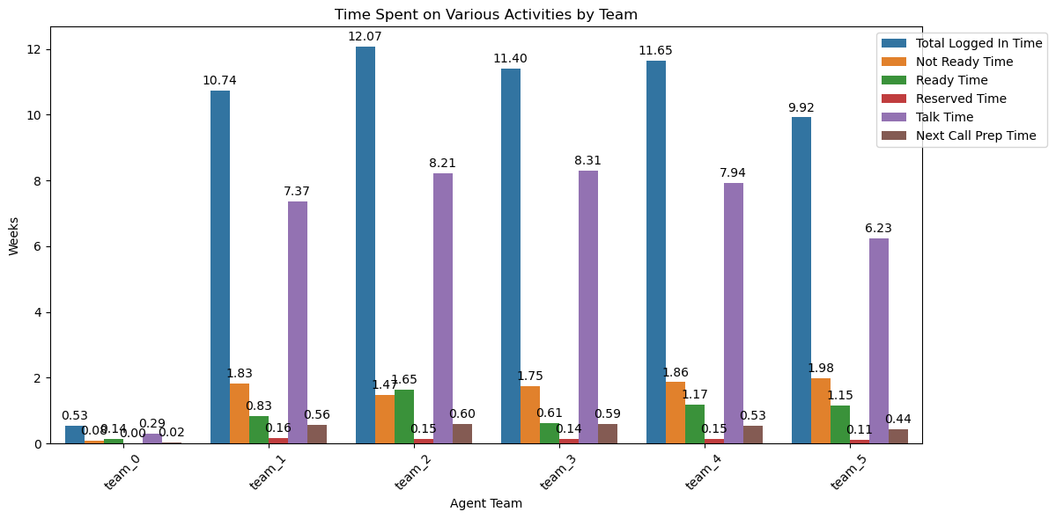
Time Spent on Various Activities by Team
Q) What is time interval each time spent on activities?
Analysis:
Talk-time seems to share more similar time amount among the teams, despite the unbalanced pattern in logged-in time and staff allocation.
This could lead to an unbalanced pattern in productivity as well (which will be checked later)

Slide 12
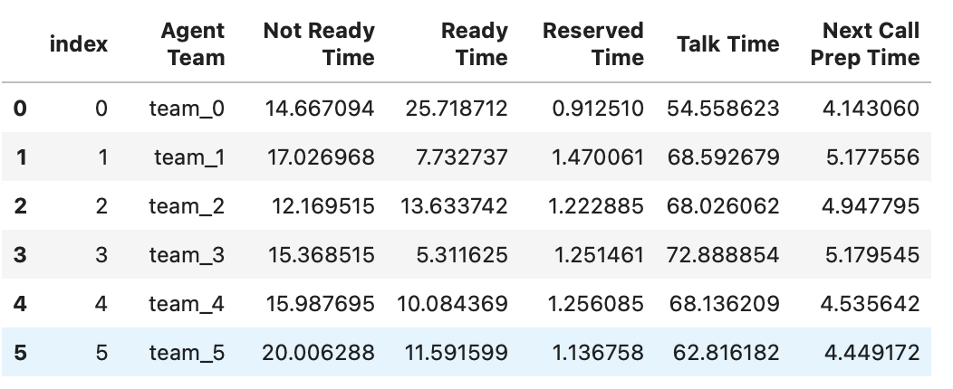
Detail of each team’s activities
Q) What percentage of logged-in time on average did teams spend on each task per time interval(on daily basis)?

Slide 13
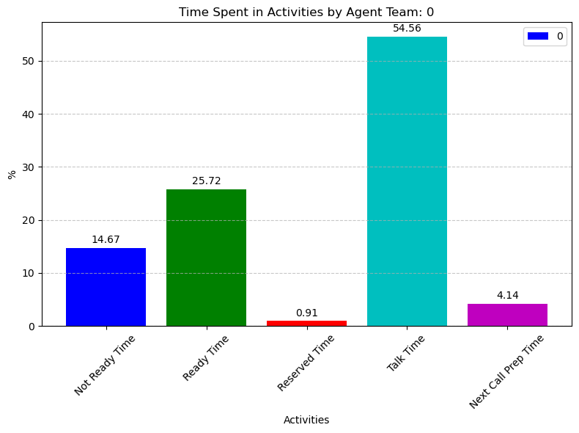
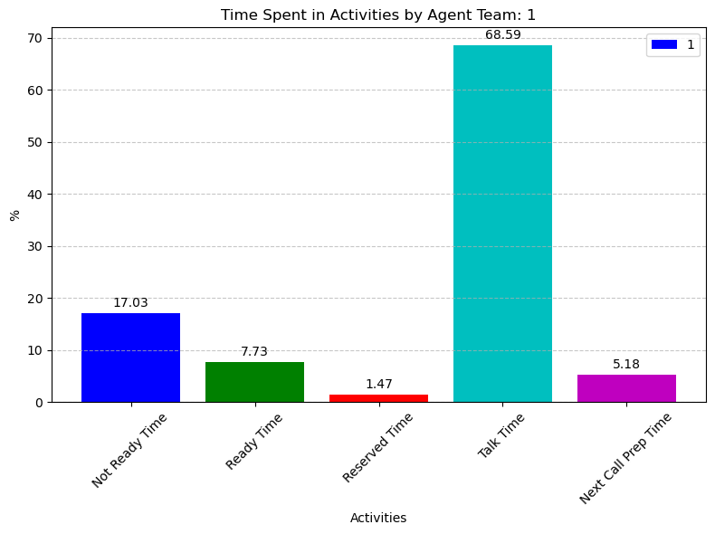
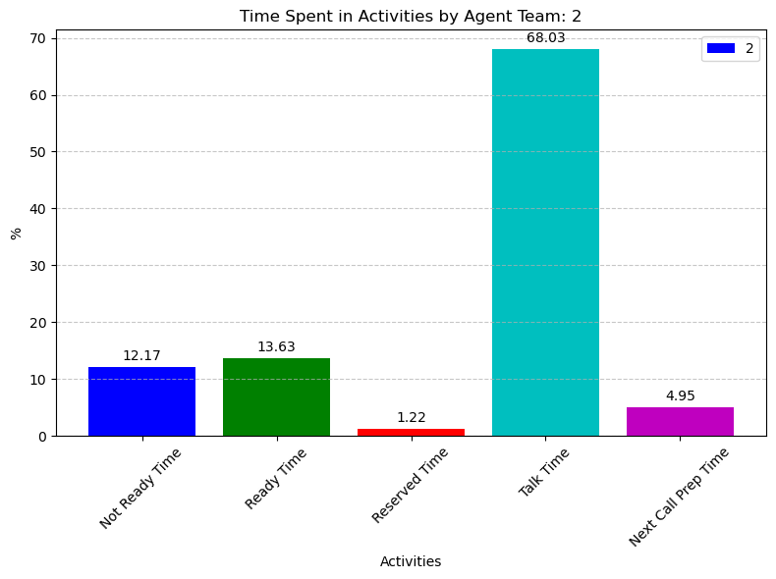
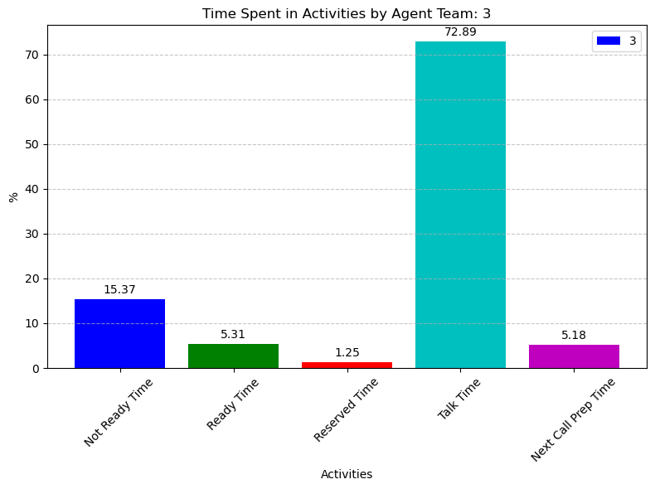
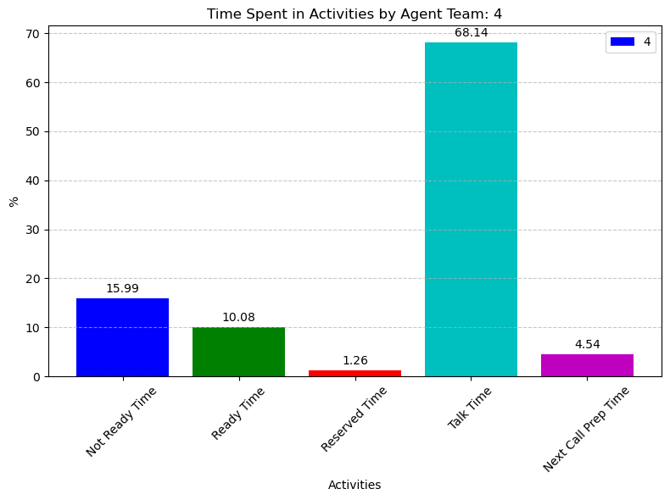
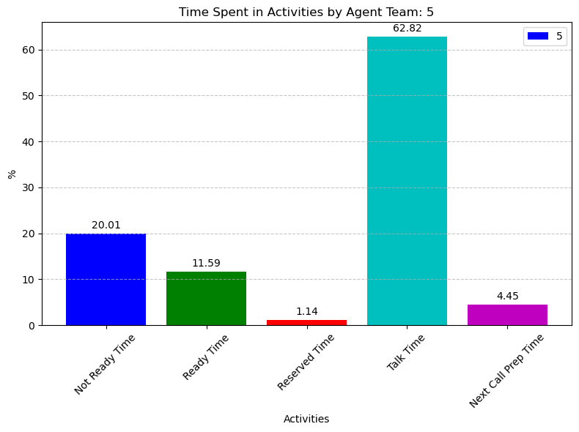
Detail of each team’s activities
Q) What percentage of logged-in time on average did teams spend on all activities per time interval(on daily basis)?

Slide 14
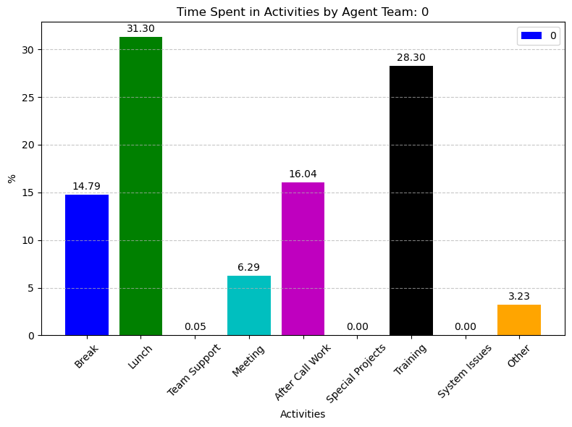
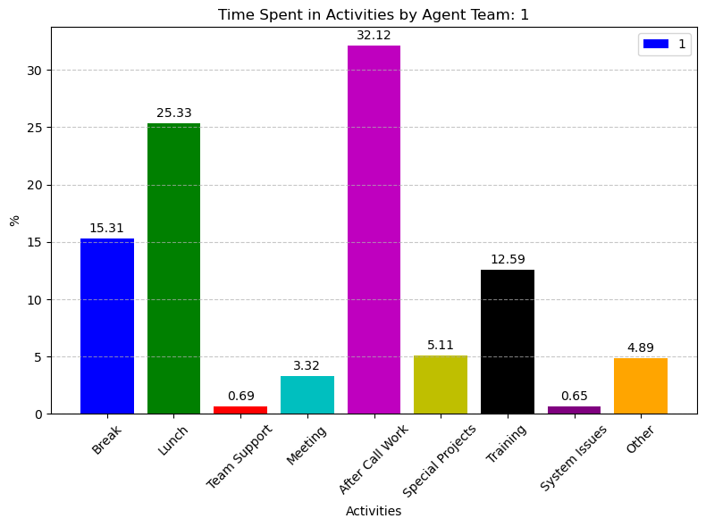
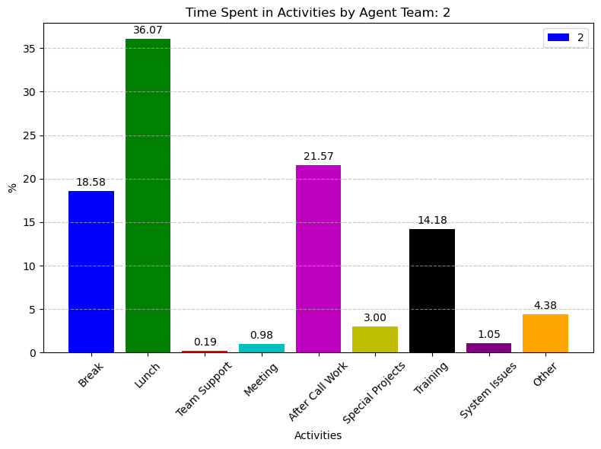
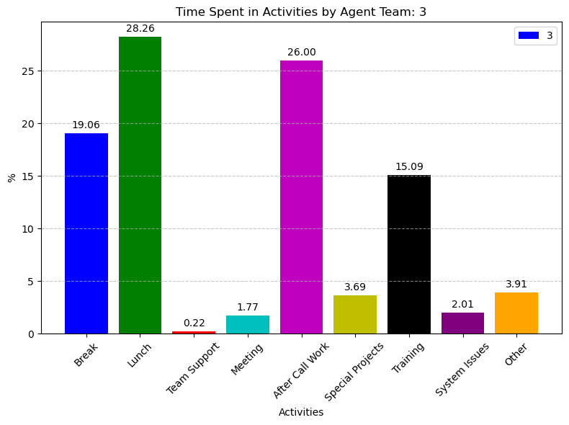
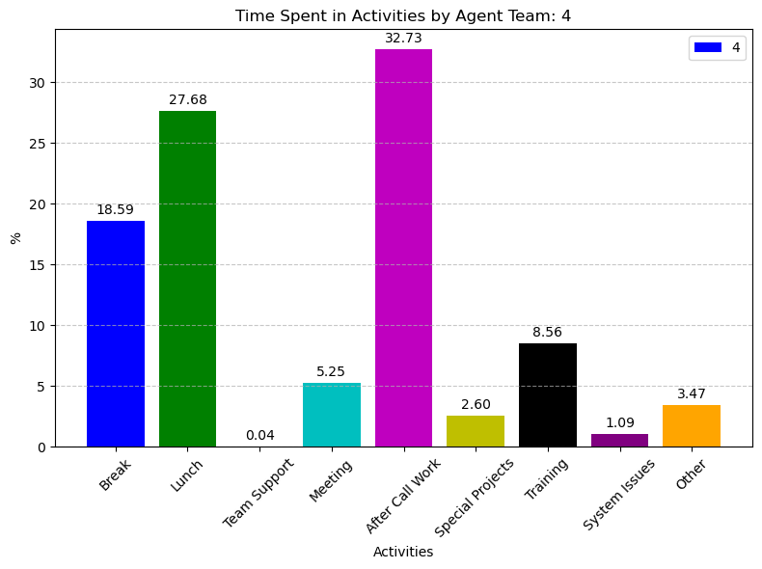
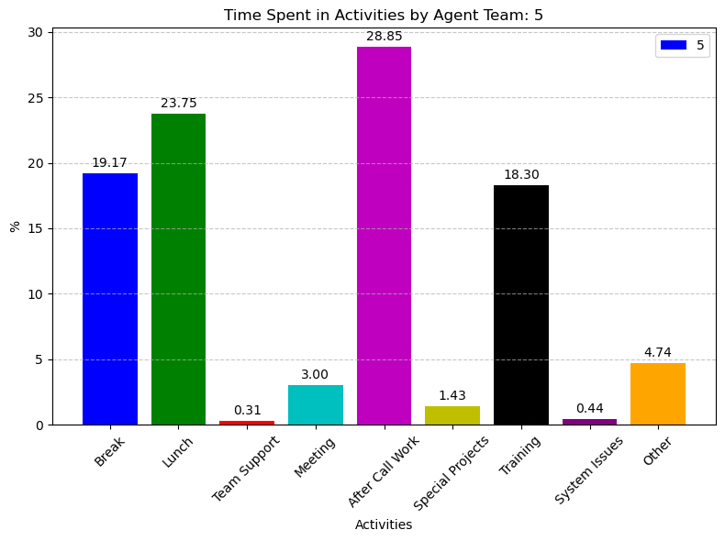
Detail of each team’s Not Ready activities
Q) What percentage of logged-in time on average did teams spend on not ready activities per time interval(on daily basis)?

Slide 15
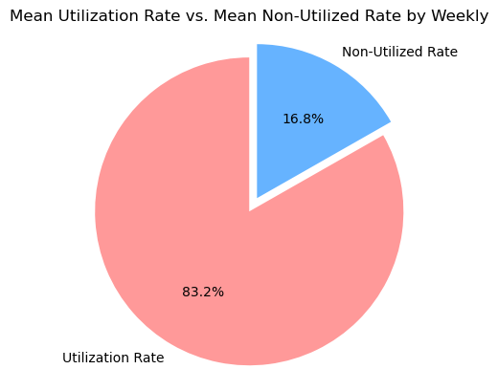
The ratio between utilization rate and non-utilized rate
Q) What is the ratio between utilization rate and non-utilized rate on weekly basis?
Analysis:
Overall, the ratio is quite reasonable.

Slide 16
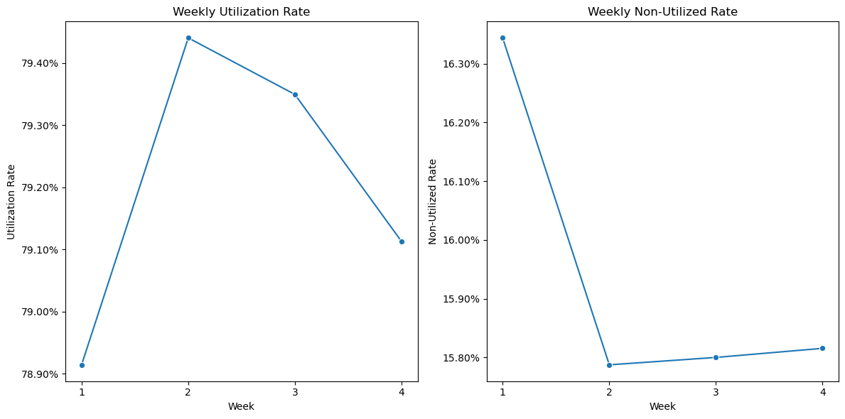
The trend between utilization rate and non-utilized rate
Q) What is the trend between utilization rate and non-utilized rate on weekly basis?

Slide 17
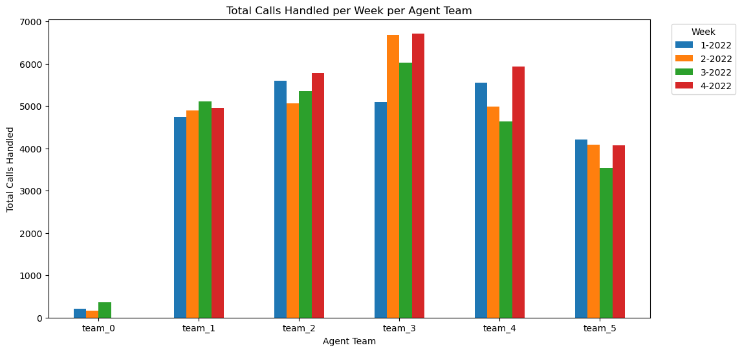
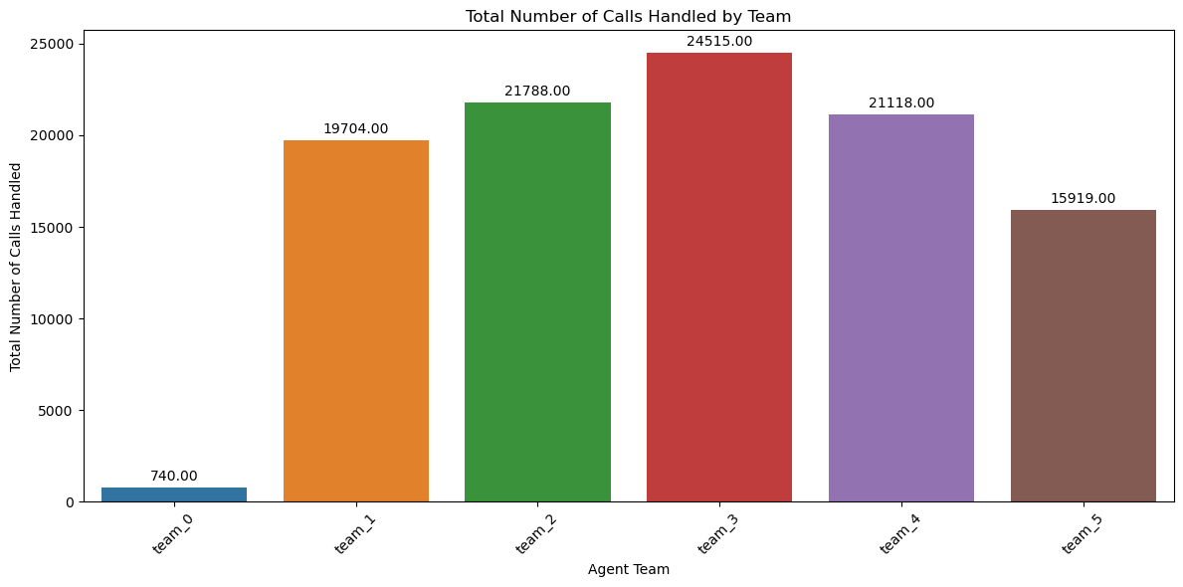
Total number of calls handled by team
Q) Which team received phone calls the most?
Analysis:
This is to see which team receives more phone calls and how it could relate to the productivity and phone call allocation per team.

Slide 18
By Agent
Agent descriptive analysis
Top/bottom perfomers

Slide 19
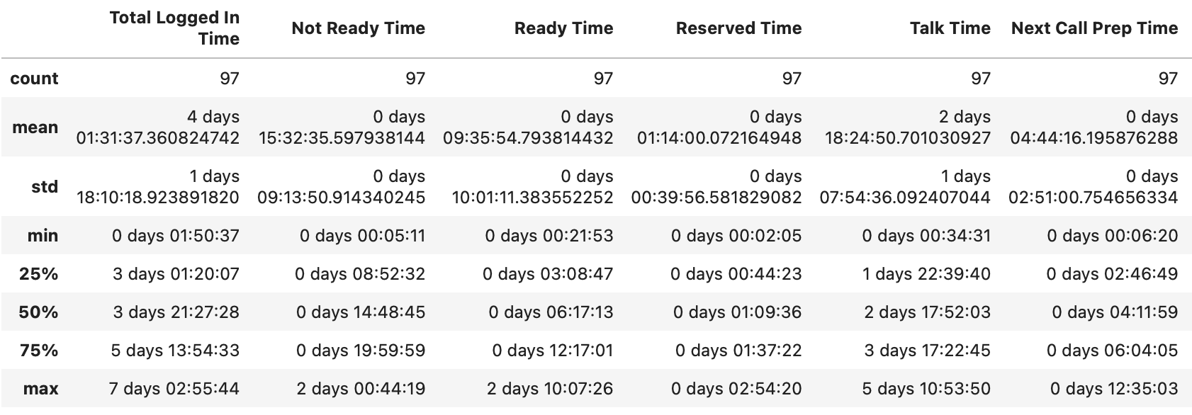
Descriptive Analysis (Agent)
Descriptive Analysis for all the activities during the agent log-in time report to track the comment pattern in what tasks agents spent time on. 5 subsets: “Not Ready Time”, “Ready Time”, “Reserved Time”, “Talk Time”, and “Next Call Prep Time”

Slide 20
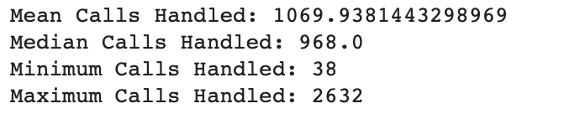
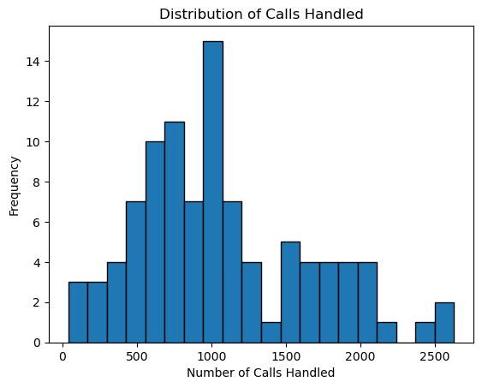
Numbers of Calls Handled by Agent Descriptive Analysis

Slide 21
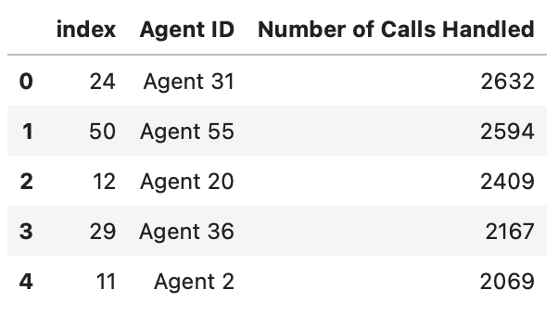
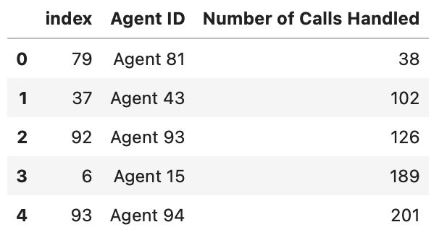
Top/Bottom Performer
Q) Who had received the most phone calls? Who needed to take more?
Top 5 performers:
Bottom 5 performers:

Slide 22
Staffing FTEs Plan
Briefly introduction of FTEs allocation

Slide 23
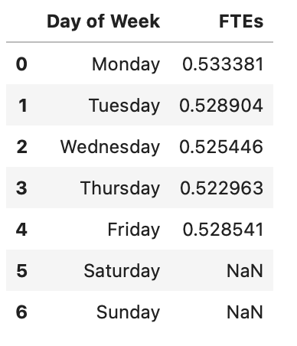
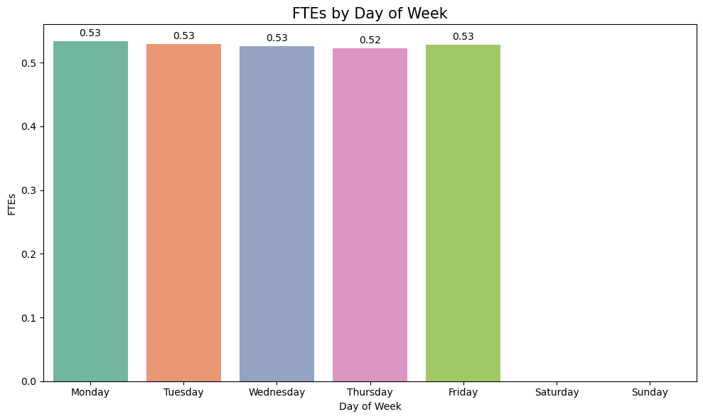
FTEs Allocation as a week
Q) Based on utilization rate, how should manager allocate FTEs?

Slide 24

Productivity Model

Slide 25
Model Construction
Scheme Introduction

Slide 26
Productivity Model
Defining a model for productivity in a call center context typically involves using key performance metrics to assess how efficiently agents and teams are handling calls. In this case, we can consider a simple model for productivity by combining metrics like utilization rate, efficiency (average handle time), and the number of handled calls.
Model for Productivity:
Utilization Rate (UR): This measures the percentage of time agents are actively engaged in productive tasks (e.g., taking calls). Higher utilization rates generally indicate better productivity.
Efficiency (EFF): Efficiency is often measured by the average handle time (AHT) per call. Lower AHT suggests more efficient call handling.
Number of Handled Calls (NHC): The total number of calls handled by an agent or team can also be an indicator of productivity.
To create a composite productivity score, we can use a weighted combination of these metrics based on their relative importance to the call center's goals. For example:
Productivity Score (PS) = w1 * UR + w2 * (1 - EFF) + w3 * NHC
Where:
w1, w2, w3 are weights assigned to each metric, reflecting their importance. These weights can be adjusted based on the call center's priorities.

Slide 27
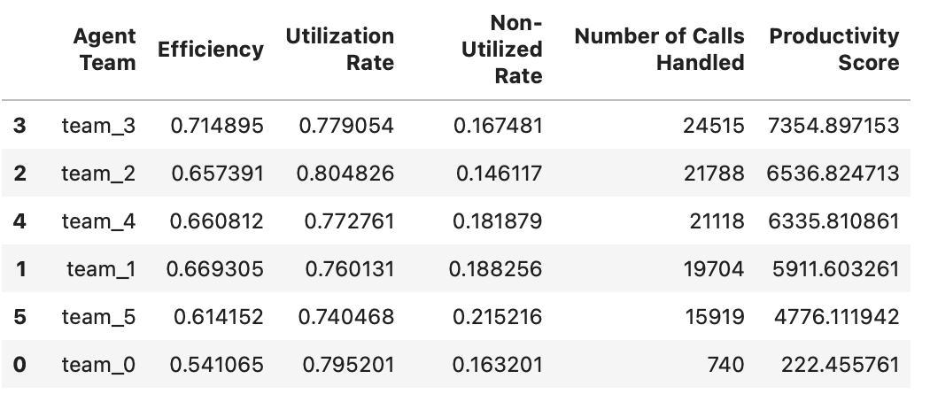
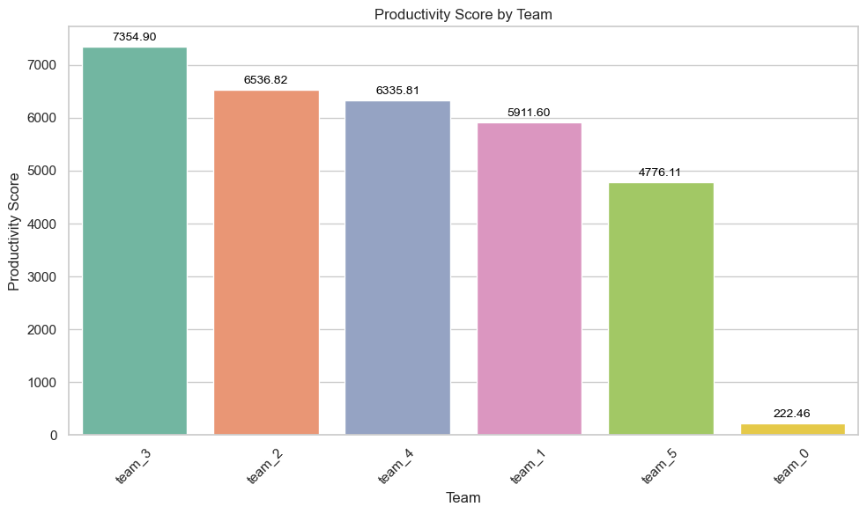
By Team

Slide 28
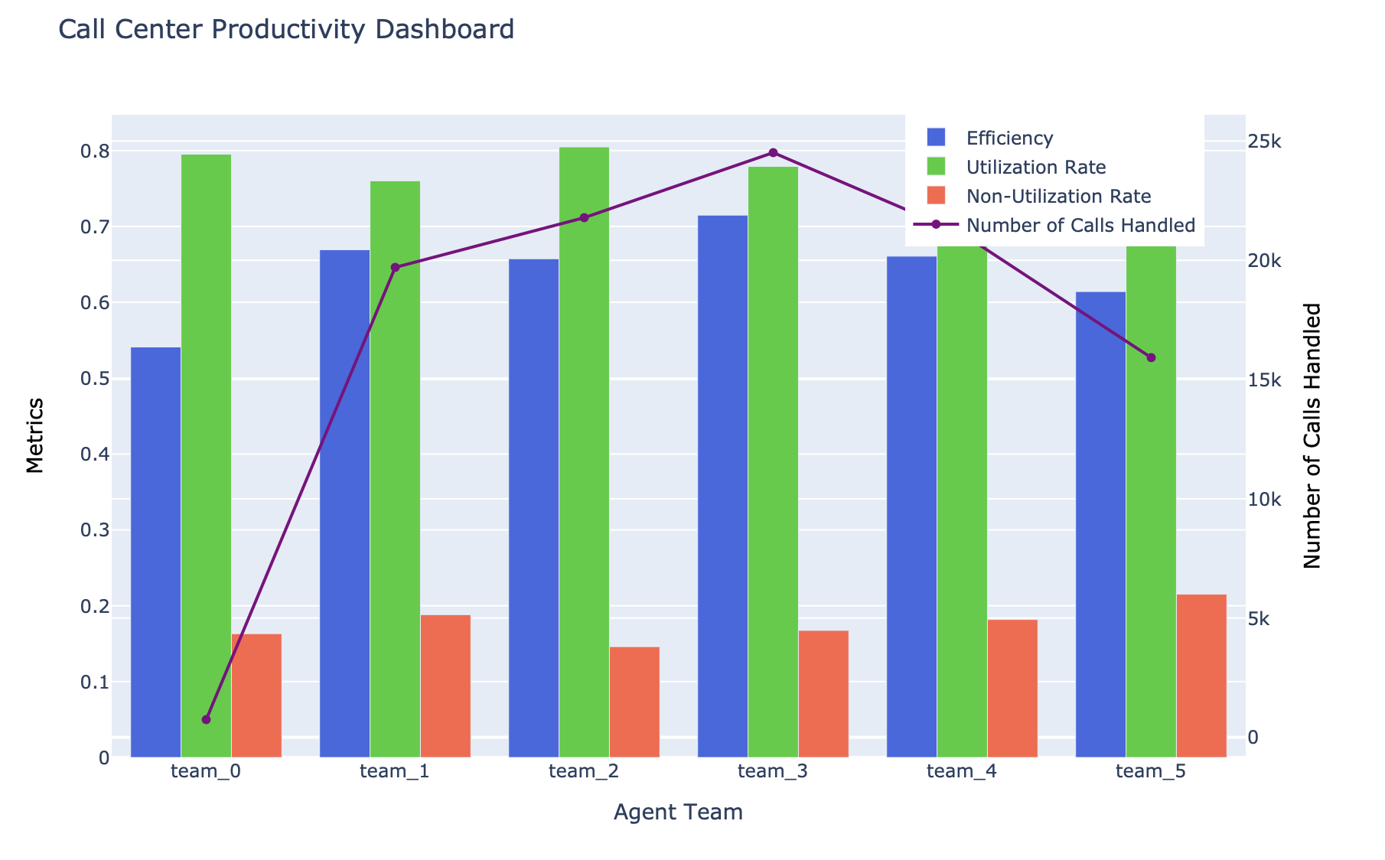
By Team

Slide 29
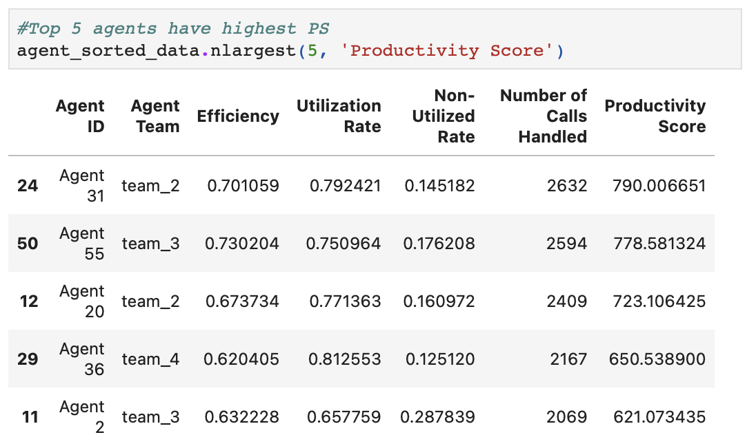
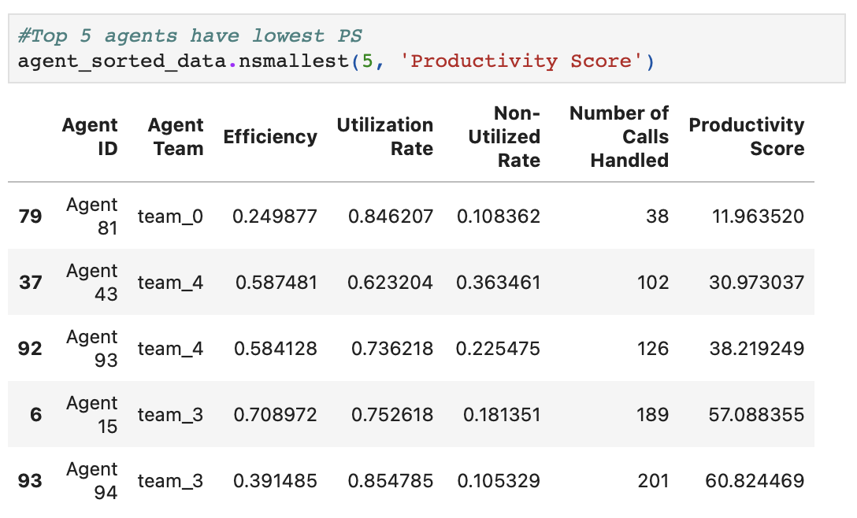
By Agent

Slide 30
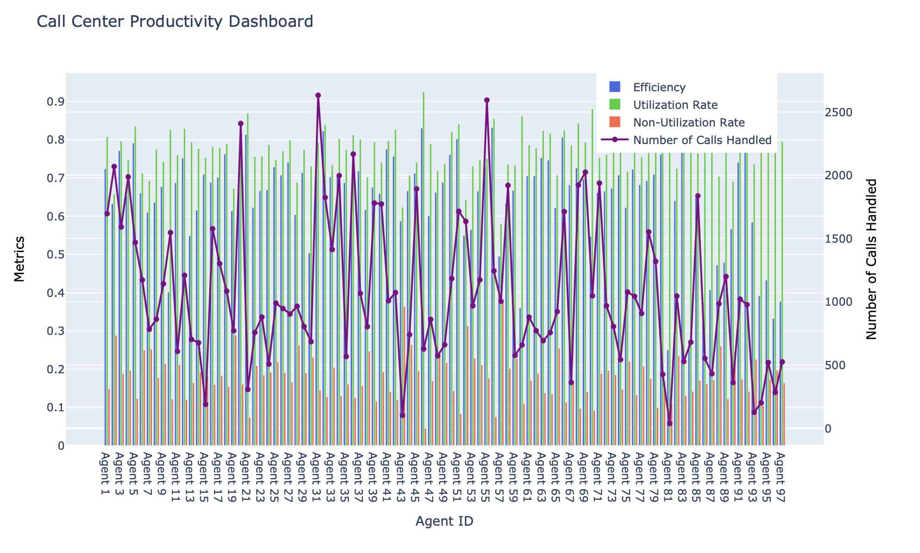
By Agent

Slide 31
Productivity Predictive Model

Slide 32
Productivity Model
1) Data Splitting:
Split the dataset into a training set and a testing set. This is typically done to evaluate the model's performance.
2) Feature Selection:
Decide which features to use for prediction. In this case, you can use 'Efficiency,' 'Utilization Rate,' 'Non-Utilized Rate,' and 'Number of Calls Handled' as your input features.
Productivity Score will be transformed into binary variables (1 for scores higher than the mean and 0 for scores lower than or equal to the mean), to predict Higher Productivity staff and Lower Productivity staff.
3) Select a Machine Learning Model:
Choose a regression model since you want to predict Productivity. In this case, we will use Logistic Regression and Decision Tree.
4) Train the Model:
Fit the chosen model on the training data, using the selected features as inputs and 'Productivity Score' as the target variable.
5) Model Evaluation:
Evaluate the model's performance on the testing set using appropriate metrics (e.g., Mean Absolute Error, Mean Squared Error, R-squared).
6) Make Predictions:
Once you are satisfied with the model's performance, you can use it to make predictions on new data.

Slide 33
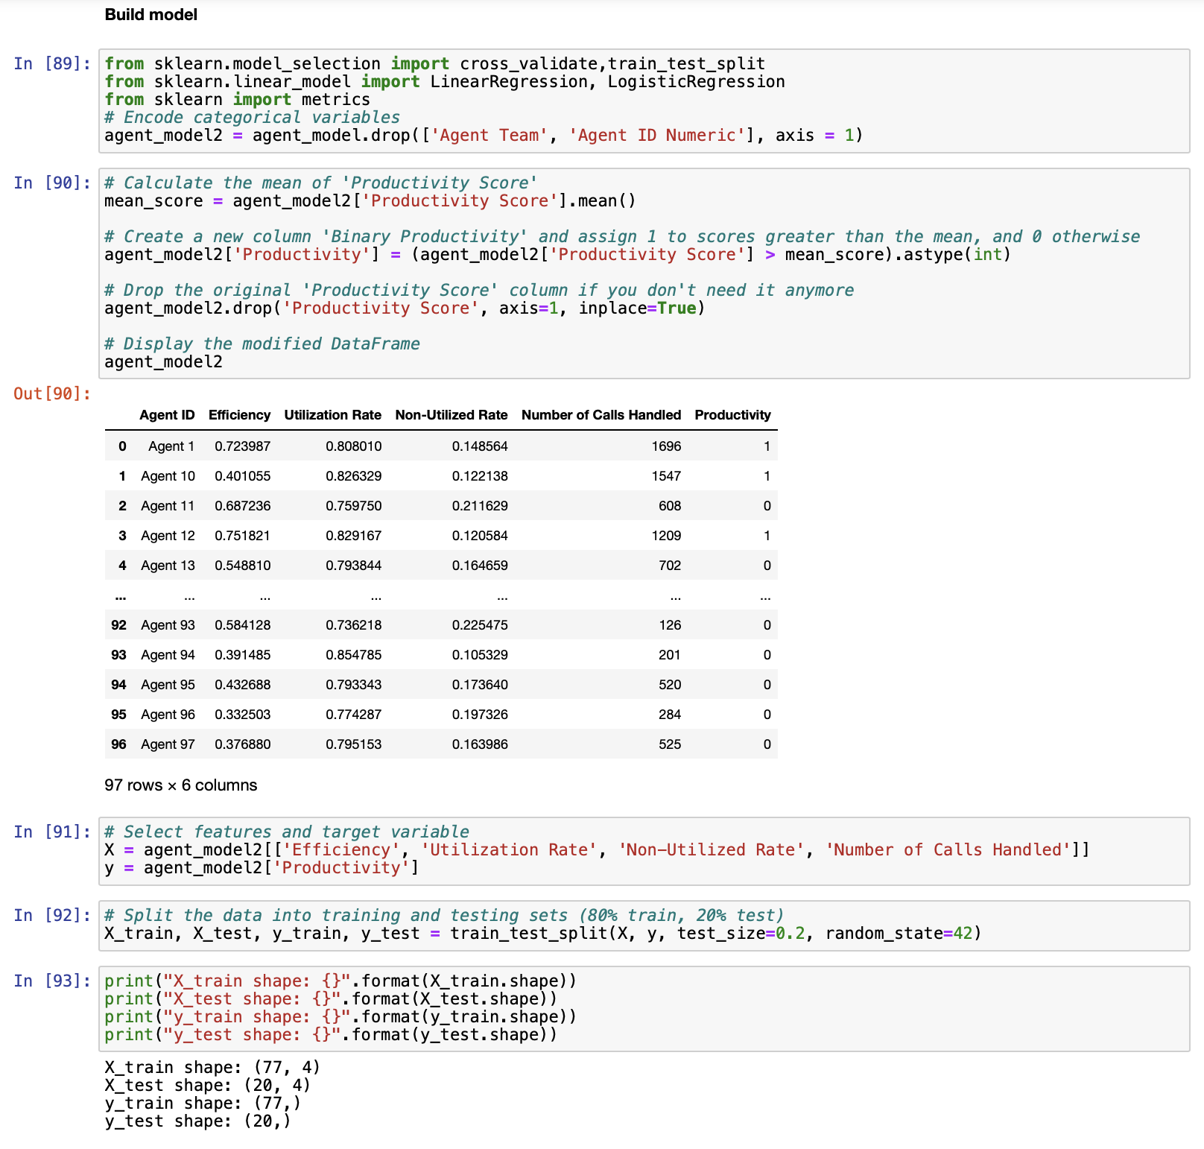

Slide 34
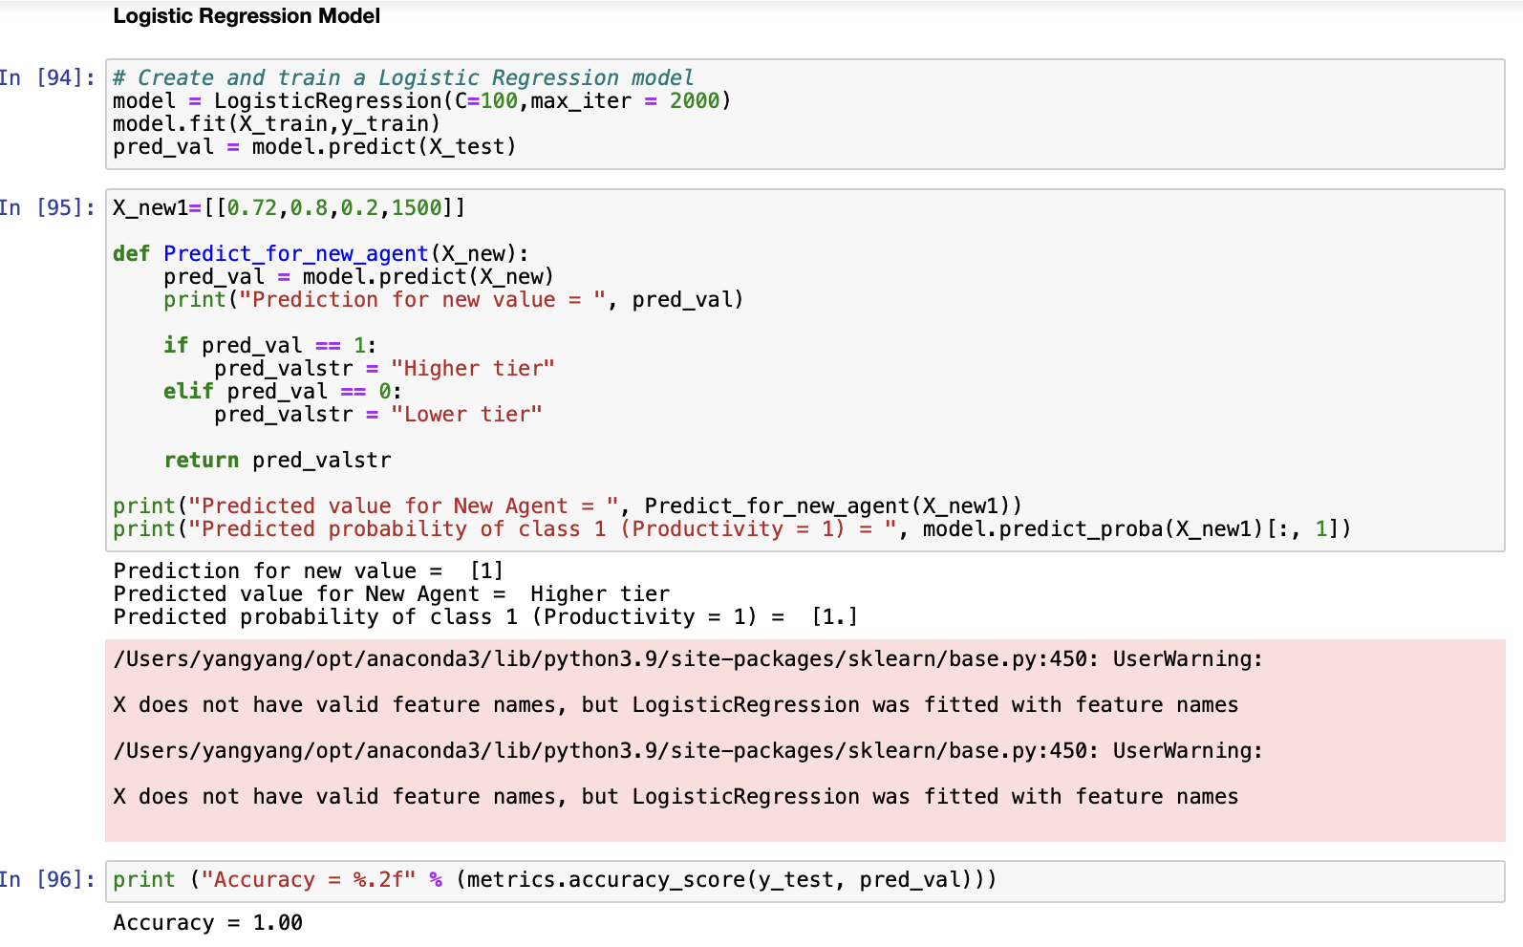

Slide 35
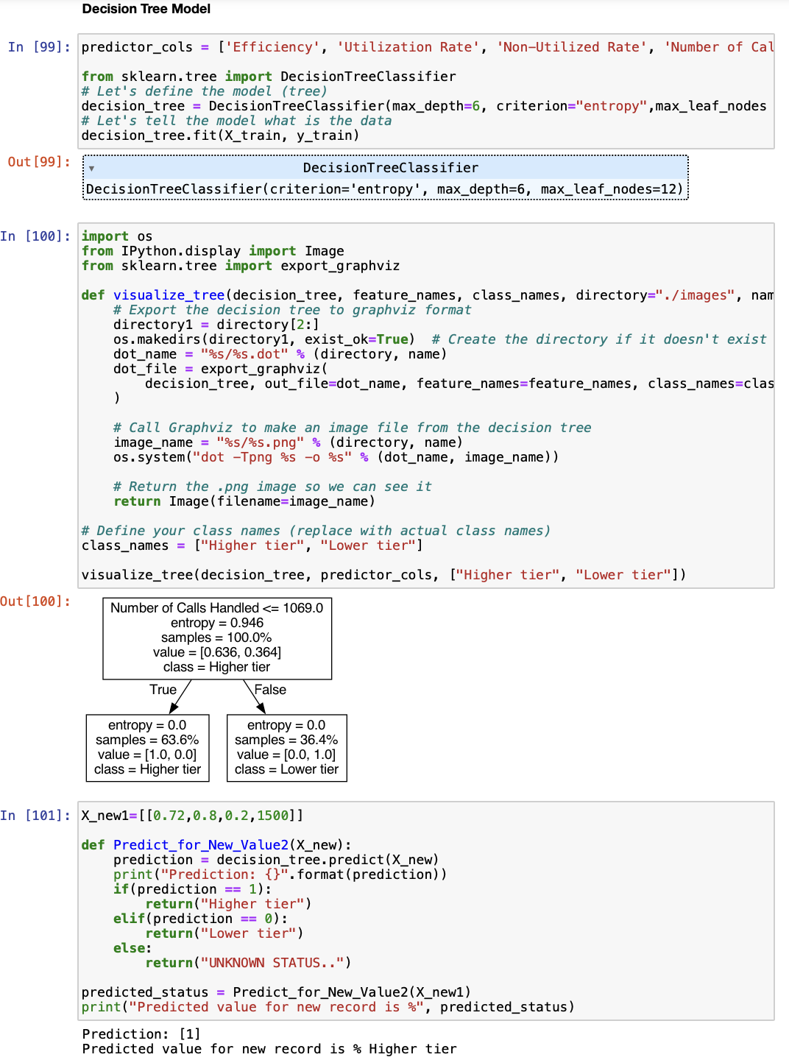

Slide 36
Thank You!

